Slide 1


Physically Based Rendering
Raymond Liu
Oregon State University

Slide 2

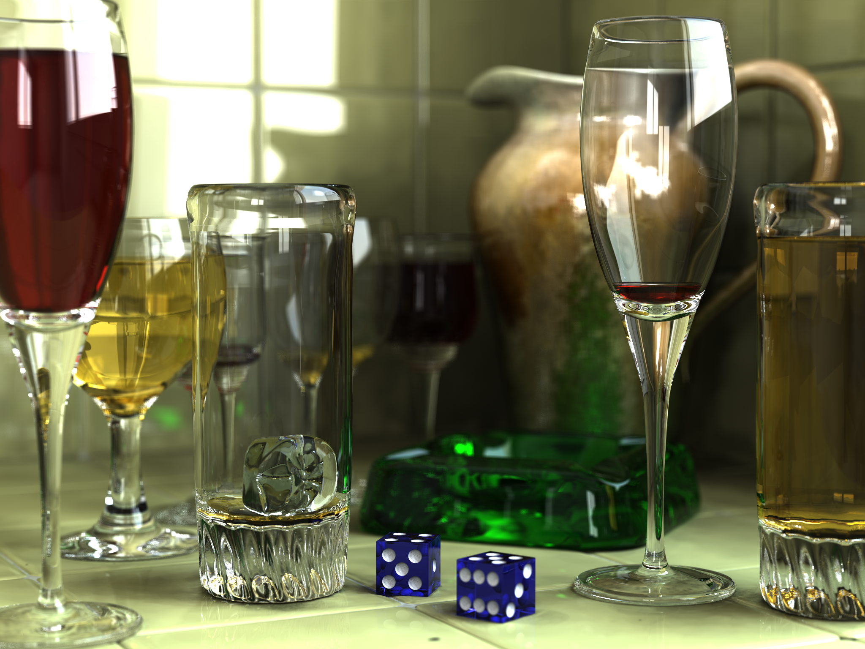
Overview
Background
Implementation
Logistics
Results
Notes:
Computer Graphics is the field of study that deals with the display and control of images on a computer screen.
Real-time computer graphics is when images are rendered quickly enough for users to be able to respond to the images for an interactive experience. The obvious example of this is, of course, video games.

Slide 3
Computer Graphics
Display and control of images on a computer screen
Different methods: rasterization, ray tracing, etc.
Ray tracing is more realistic as well as more intensive
This internship: Ray Tracing
How do we make our images more realistic and the rendering process faster?
Notes:
Computer Graphics is the field of study that deals with the display and control of images on a computer screen.
There are several different methods for creating images. For example, rasterization is a method that is commonly used in video games or other real-time applications.
Ray tracing, on the other hand, is a much more advanced and realistic, as well as highly intensive, way of rendering a scene. Ray tracing is what I focused on in my internship.

Slide 4
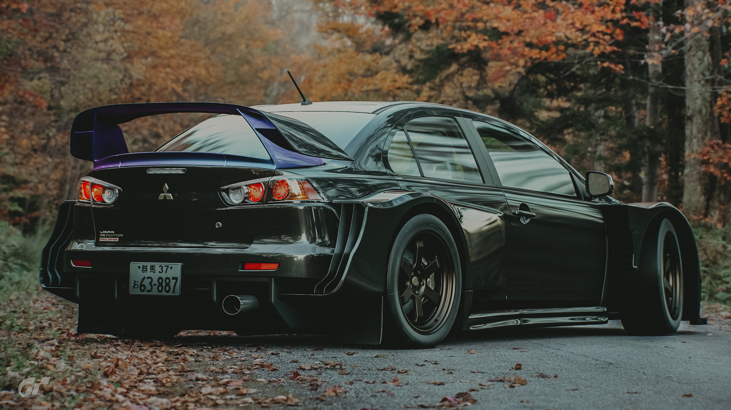
Gran Turismo Sport (2017)
Notes:
Over time, many improvements have been made in the field of computer graphics, making things more and more realistic. For example, this picture is taken from a video game released just last year. Since this was done with rasterization, the reflections on the car as well as the shading had to be done manually.

Slide 5
Ray Tracing – Implementation
All objects we see are illuminated by light
Trace light beams backwards from our eyes to the light source and simulate how the light interacts with these objects
Shoot ray(s) for each pixel
Notes:
Ray tracing is guided by the concept that all the objects we see are illuminated by light.
In ray tracing, we attempt to simulate how the light interacts with objects along its path from the light source to various objects to our eyes.
So the general concept is that we trace light rays backwards, from our eyes to various objects to the light’s source. We shoot a ray from the camera to each pixel on the screen and see what it hits.
It is important to note that in rasterization, light effects such as reflection or shading must be approximated using various tricks; in ray tracing it can be perfectly simulated.

Slide 6
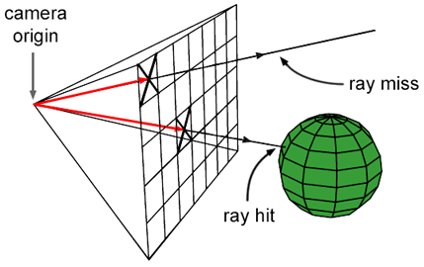
Rays and Objects
Start each ray at the camera – trace its path through a select pixel
Test for intersections with the objects in the scene – take the closest intersection and simulate the interaction between the ray and the object
Continue to trace the ray until it hits no objects or we terminate it
The result: one RGB color for the pixel we selected
Notes:
Rays are defined by a starting point and a direction. We start each ray at a set point and direct it based on which pixel we want to color. Then we test for intersections between that ray and all the objects in the scene. If it hits an object, we then simulate the interaction between the ray and that object and the ray bounces off the surface. We continue this process until we don’t hit anything or we manually terminate the ray.

Slide 7
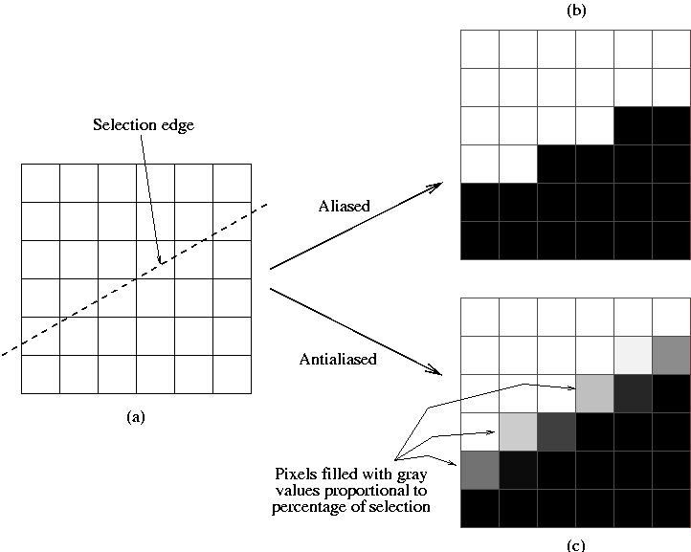


Rays and Objects
Antialiasing: send more than one ray per pixel, average the colors returned by each ray – this smooths rough edges
Without antialiasing
With antialiasing
Notes:
Antialiasing is where you send more than one ray per pixel and get the average of the colors. This smooths rough edges and reduces noise.

Slide 8
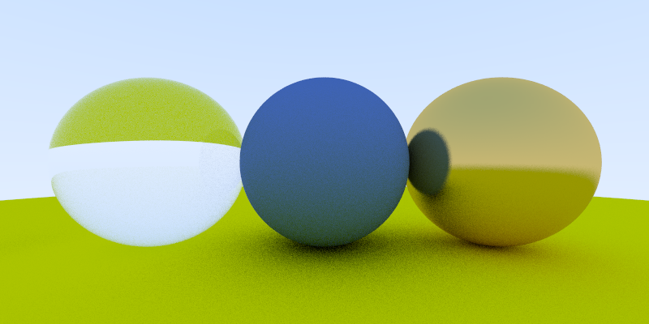
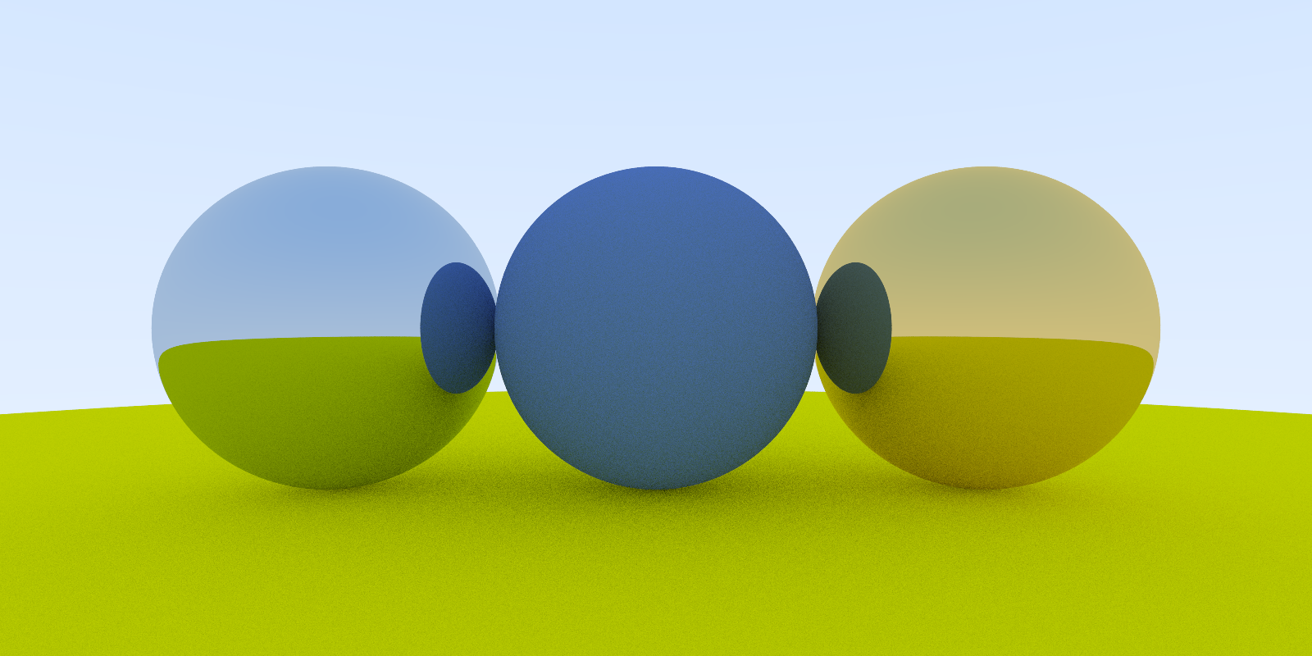
Rays and Objects
Example: 3 spheres of different materials (metal and diffuse)
The ray interacts with each object and material differently.
Notes:
Here is an example of three spheres. The left and right spheres have metal material and reflect just like a mirror.

Slide 9
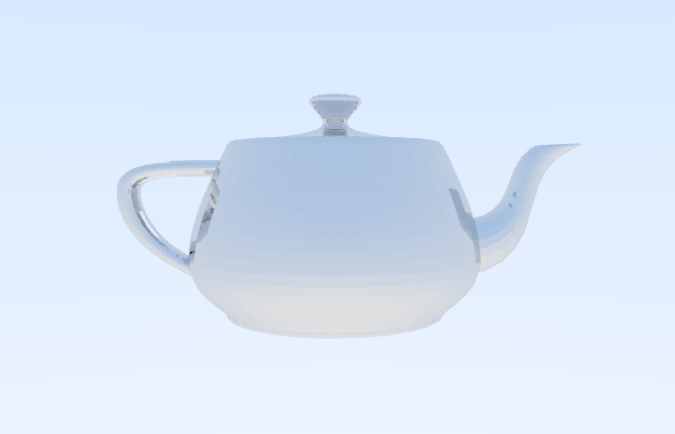
Acceleration
If we put together a bunch of triangles, we can make a mesh
These meshes can have thousands, or even hundreds of thousands of triangles
This can make rendering extremely slow
Notes:
By putting a bunch of triangles together in our scene, we can make a mesh like this teapot. Often times these meshes have a ton of triangles, which can make rendering an image extremely slow.

Slide 10
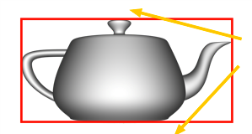
Acceleration – Bounding Volume
Let each object have a volume that tightly bounds it
These bounding volumes are easier to test for intersections
Instead of testing the objects for ray intersections, test the bounding volumes
If the ray misses the bounding volume, then we know the object cannot be hit
Notes:
A simple way to speed up rendering time is by using bounding volumes. The basic idea is that you have a volume that bounds all of the triangles in a mesh. When you shoot a ray, instead of having to test for an intersection with each triangle, you can just see if it hits the bounding volume, since testing a single volume instead of the triangles is a lot faster. If the ray misses the volume, we know the ray can’t hit the mesh.

Slide 11
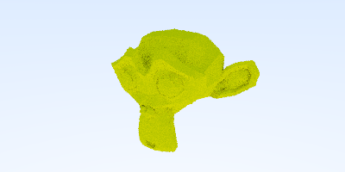
400x200 resolution – 968 triangles – 180 second render time
Reduced to 130 seconds with a single axis-aligned bounding box
Notes:
This monkey head, which has 968 triangles, originally took 180 seconds to render. By using a single bounding volume – which, in this case, is a box – the render time is reduced to 130 seconds.

Slide 12
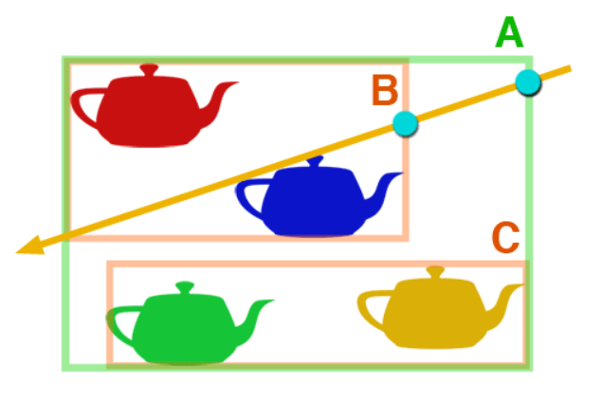
Acceleration – Bounding Volume Hierarchy
We can also have bounding volumes that contain other bounding volumes
This is a Bounding Volume Hierarchy (BVH) – it helps speed things up even more when there are many objects
Notes:
For more complex scenes with several meshes, we can use a Bounding Volume Hierarchy to further speed things up. A BVH is essentially just a bounding volume that contains other bounding volumes. These smaller bounding volumes can also contain others as well.
For example, look at this graphic. Instead of testing 5 bounding volumes for each ray that we cast, we can first test the biggest bounding volume. If the ray hits that, we can test the smaller volumes, and so on.

Slide 13
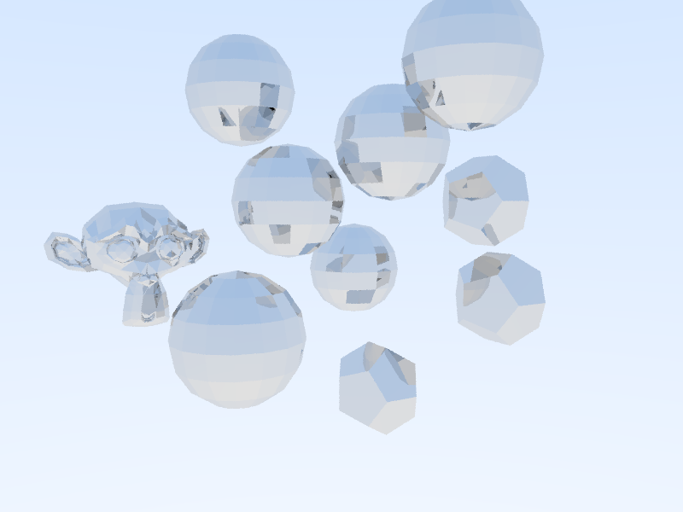
800x600 resolution – 2420 triangles – 11 second render time
Used a bounding volume hierarchy
Notes:
This scene contains 2420 triangles and has a higher resolution than the previous image. By using a BVH it takes only 11 seconds to render.

Slide 14
Lighting
We can add a light source for shading
At each ray-object intersection, draw a line from the intersection point to the light source
If the line doesn’t hit any objects, that means we can add light to that point
Otherwise, the point will remain in the dark
Notes:
Next up is lighting. By adding a light source, we can have light effects such as shading in our images.
At each ray-object intersection, we cast a shadow ray from that point to a point on the light. If the shadow ray doesn’t hit any other objects, then we can “see” the light from that point. Otherwise, the light is blocked and we won’t add any lighting to that point.

Slide 15
Monte Carlo Path Tracing (MCPT)
The rendering equation:
Outgoing light = Emitted light + integral(BRDF * Incoming light * Incident angle)
By approximating the integral using Monte Carlo methods, we can get an algorithm for determining the reflected light from an object
Bidirectional Path Tracing
While MCPT only shoots rays from the camera, in Bidirectional Path Tracing (BDPT), we trace rays from the camera as well as from the light and connect these paths.
$$L_{o}\left(x,w\right)=L_{e}\left(x,w\right)+\int_{Ω}^{ }{f_{r}\left(x,w^{′},w\right)L_{i}\left(x,w^{′}\right)\left(−w^{′}∙n\right)dw^{′}}$$
Notes:
In Monte Carlo Path Tracing, we attempt to solve the rendering equation, shown here, using Monte Carlo Integration. Doing so will allow us to approximate the outgoing light from an object based on the incoming light and the object’s emittance.
In Bidirectional Path Tracing we shoot rays from both the camera and the light source. By connecting these paths, we can get a better and more balanced image than we would by using MCPT.

Slide 16
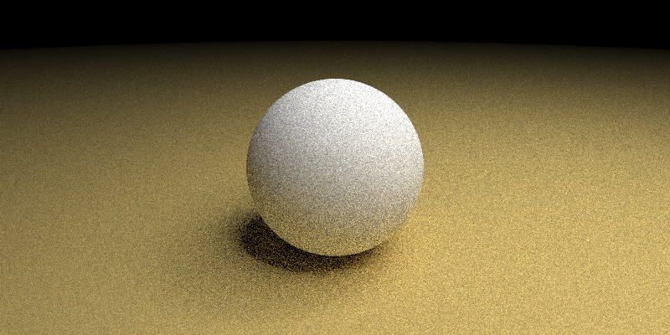

Monte Carlo Path Tracing
We introduce a single spherical light; the background is dark.
BDPT produces higher quality images than MCPT at the cost of increased complexity.
Notes:
In these two images we have a single spherical light. The left was made using Monte Carlo Path Tracing, while the right used Bidirectional Path Tracing.
BDPT produces images of better quality than MCPT, but it is more complex and thus takes more time. However, BDPT takes less time to produce the same quality image as MCPT.

Slide 17
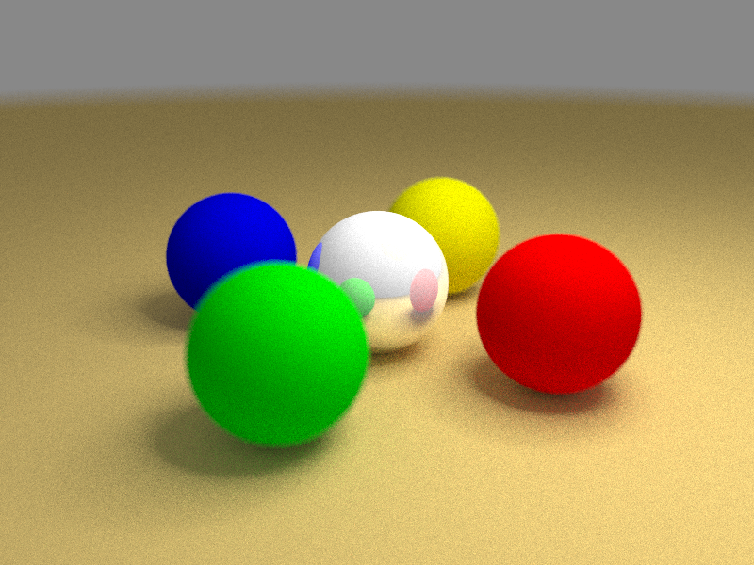
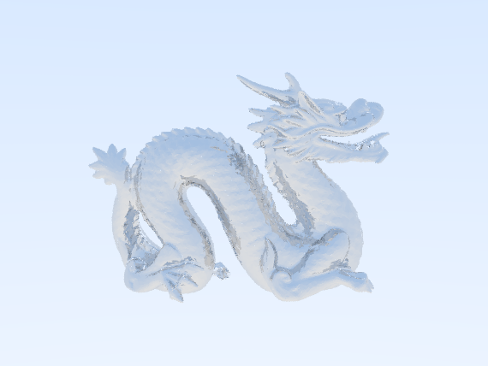
Results
We can place objects with varying colors and materials in the scene and introduce realistic lighting effects with MCPT or BDPT.
This dragon has 100,000 triangles (!)
and took 360 seconds to render.
Notes:
Here are the results I have so far from the ray tracer I built.
On the left is a scene with 5 small spheres. By using Monte Carlo Path Tracing or Bidirectional Path Tracing, we can simulate how light interacts with these objects for a realistic effect.
On the right is a dragon mesh that has 100,000 triangles. The use of a Bounding Volume Hierarchy makes the render time relatively short.

Slide 18
References
Physically Based Rendering: From Theory to Implementation. Matt Pharr, Wenzel Jakob, Greg Humphreys.
Realistic Ray Tracing – 2nd Edition. Peter Shirley, R. Keith Morley.

Slide 19
Acknowledgements
Mentors:
Dr. Eugene Zhang
Dr. Yue Zhang
Mr. Jinta Zheng
Ms. Fariba Khan
Teacher Monitor:
Ms. Cara Benfield

